Slide 1
Project Discussion
17th February 2025

Slide 2
How does YOLO work?
Grid Division: YOLO divides an image into an S×S grid. Each grid cell is responsible for detecting objects whose centers fall within it.
Anchor Boxes and Predictions: For each grid cell, the network predicts multiple bounding boxes using pre-defined anchor boxes. Each prediction includes:
Bounding Box Coordinates and a Confidence Score: The confidence score reflects both the probability of an object being present and the quality of the bounding box prediction (related to the Intersection over Union, or IoU).
Class Probabilities: A vector that indicates the probability of the object belonging to each class.
Post-Processing with NMS: After the predictions are made, non-maximum suppression (NMS) is applied to remove duplicate detections. NMS uses IoU to determine which overlapping bounding boxes should be kept and which should be discarded.

Slide 3
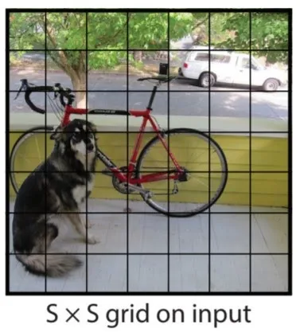
The algorithm first divides the image into S by S grids. Each cell produces multiple bounding boxes. Each bounding box has a vector and these vectors are called anchor boxes.

Slide 4
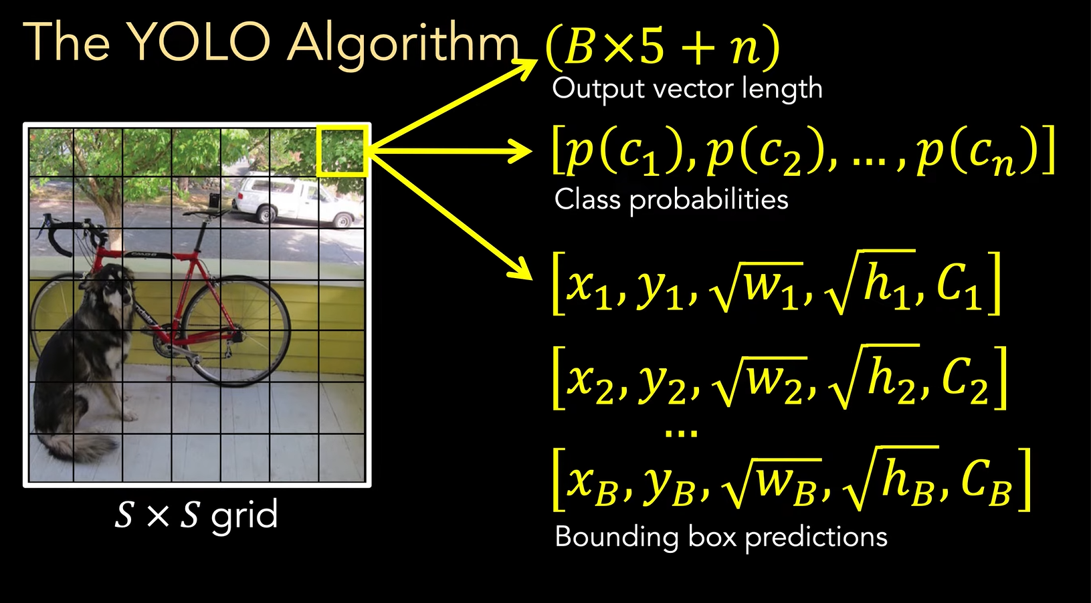
As mentioned before, each cell produces bounding box vector, the vector consist the center of the bounding box’s object (x and y), the width and height of the object (w and h), the confidence of prediction (C), and the probability of each class P(C) being present in the given bounding box.
As a cell can have multiple bounding boxes, so instead of having multiple vectors it creates one vector for each cell, and the shape of the vector is B x 5 + n, where B is the number of bounding boxes and n is the probability of each class.

Slide 5
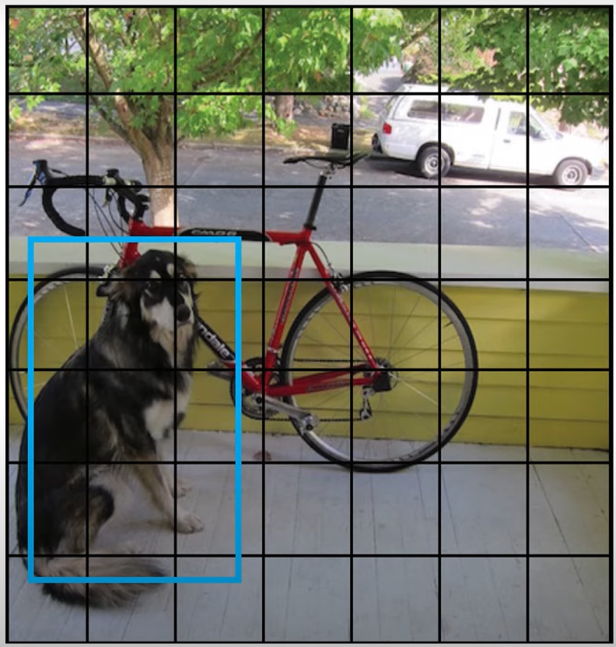
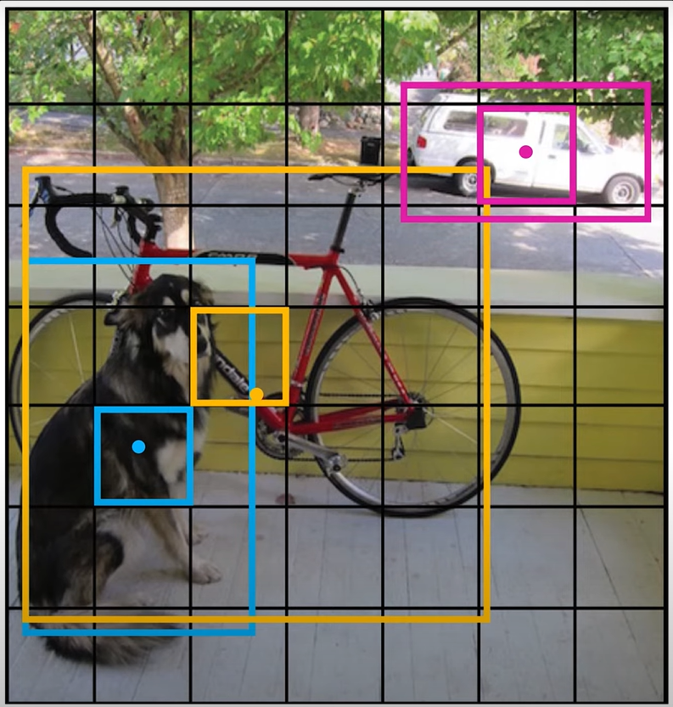
The dots are the center of the object and the cells they are present in are responsible for predicting the bounding boxes
The blue box is the ground truth (annotated) and we are training the model to learn this bounding box

Slide 6
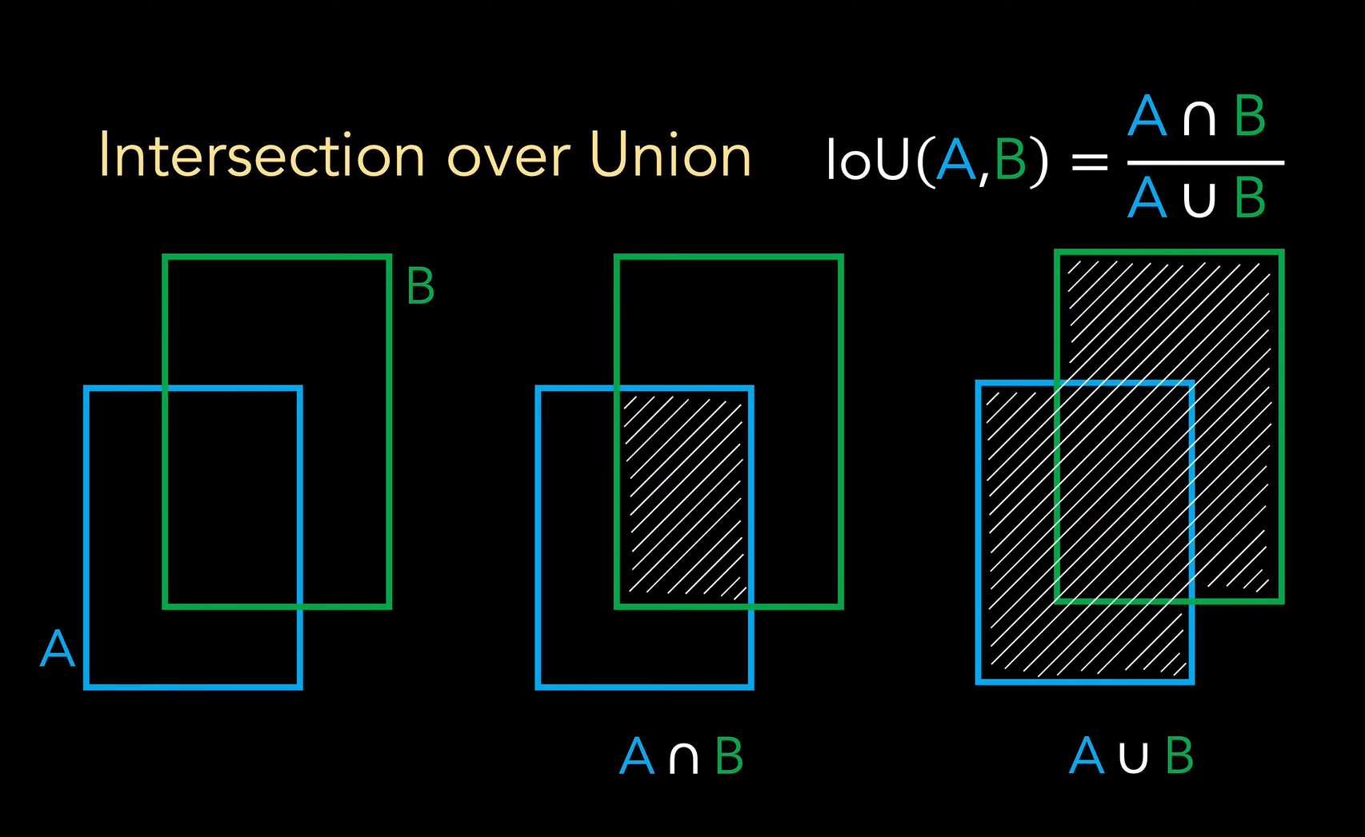
Intersection over union (IoU) is basically calculating the area of intersection and then dividing it by the union of both the areas.
This method is important as it is used in training and inference both.

Slide 7
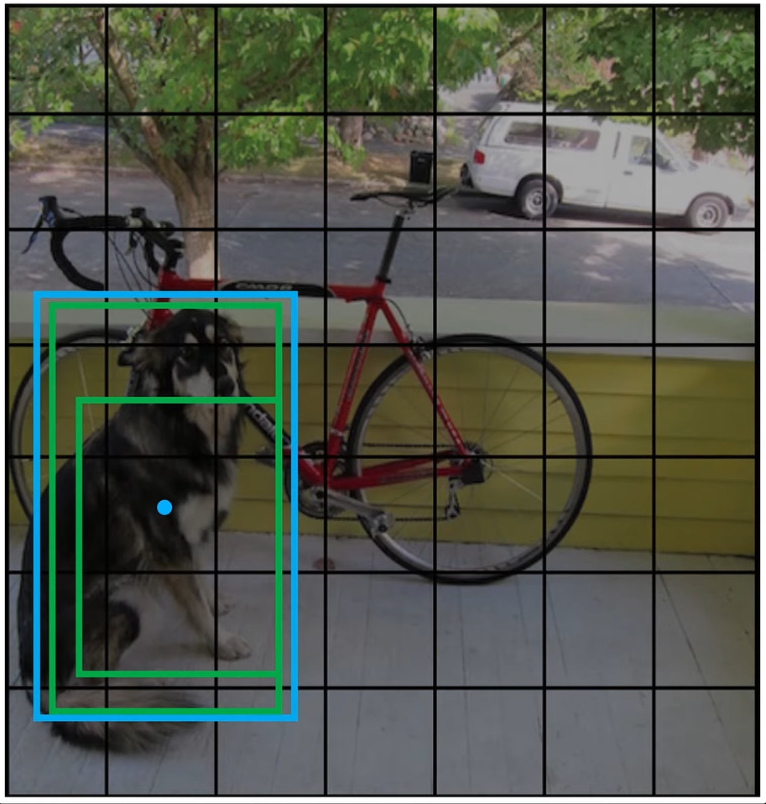
During Training, the algorithm uses IoU between the predicted bounding boxes (green boxes) and the ground truth bounding boxes (blue box), and the box with the highest IoU is kept and the other are removed.

Slide 8
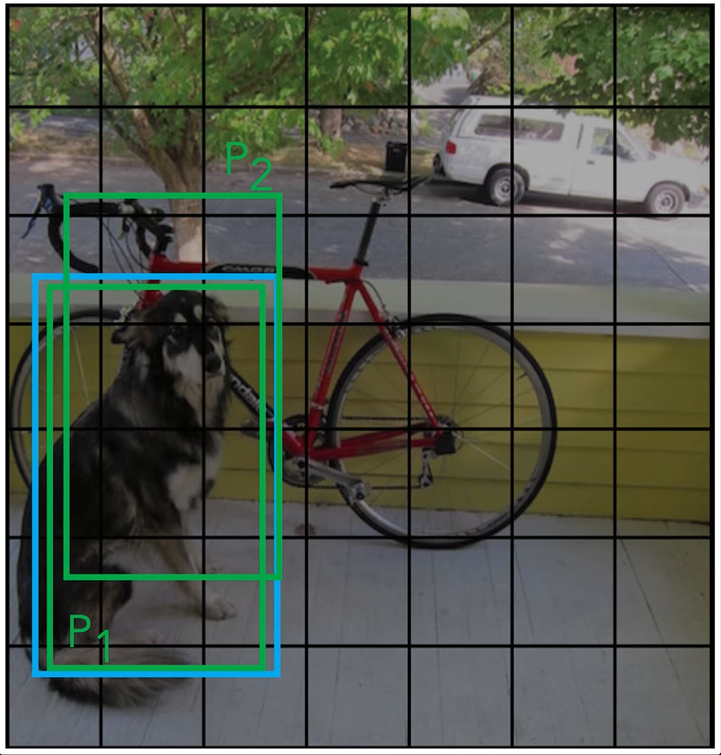
During Testing/Inference, it first calculates the IoU on the predicted boxes and then if it meets a certain threshold, it then understands that these predicted bounding boxes are for the same object, then based on the confidence score of these objects it chose the predicted bounding box with the highest confidence score. This process/method is called Non Max Suppressions (NMS).
YOLO uses a multi part Loss Function:
Localization Loss Function: Used to penalize bounding box predictions
Confidence Loss: This helps determines if an object is present in a grid cell. It uses Mean Squared Error (MSE) to compare the predicted objectness score with the Intersection over Union (IoU) between the predicted and ground truth boxes.
Classification Loss: Uses Binary Cross Entropy Loss (BCE) for penalizing false Classifications.

Slide 9
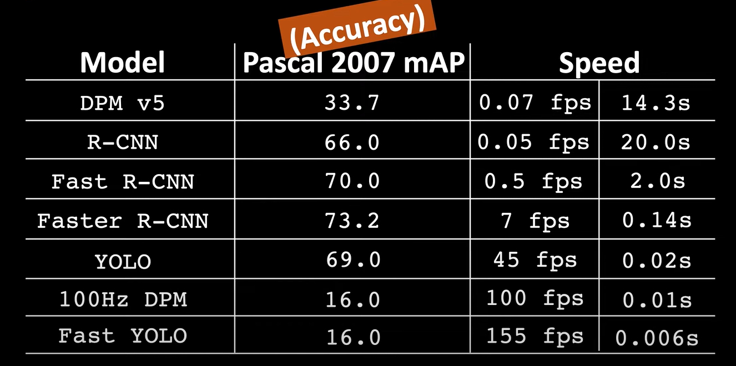
Why YOLO?
When compared to Faster R-CNN YOLO is very fast and provides almost the same accuracy. And the newer versions of YOLO have worked on improving their accuracy

Slide 10
Tasks Completed
Chart Generation: We have created chart and found charts, for annotation
Annotation: We have completed the Annotation Process

Slide 11
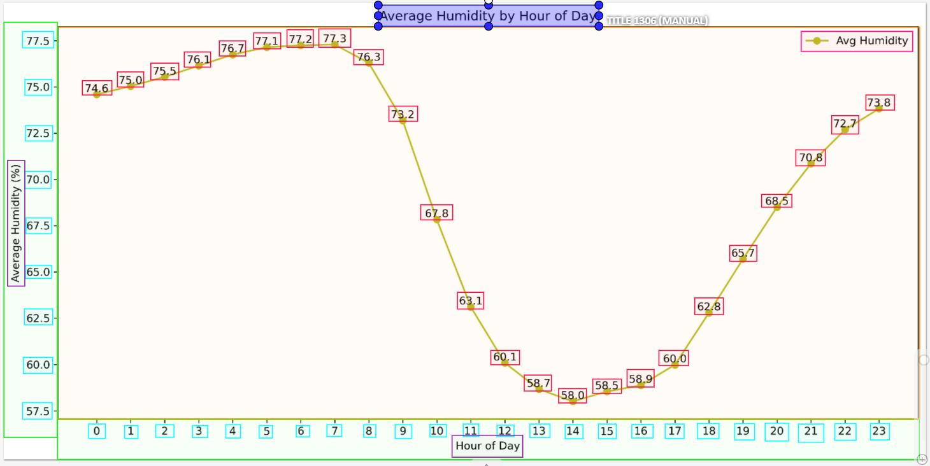
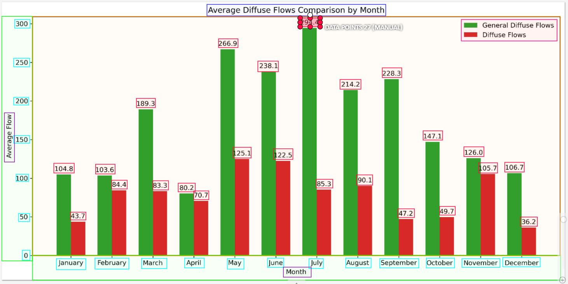
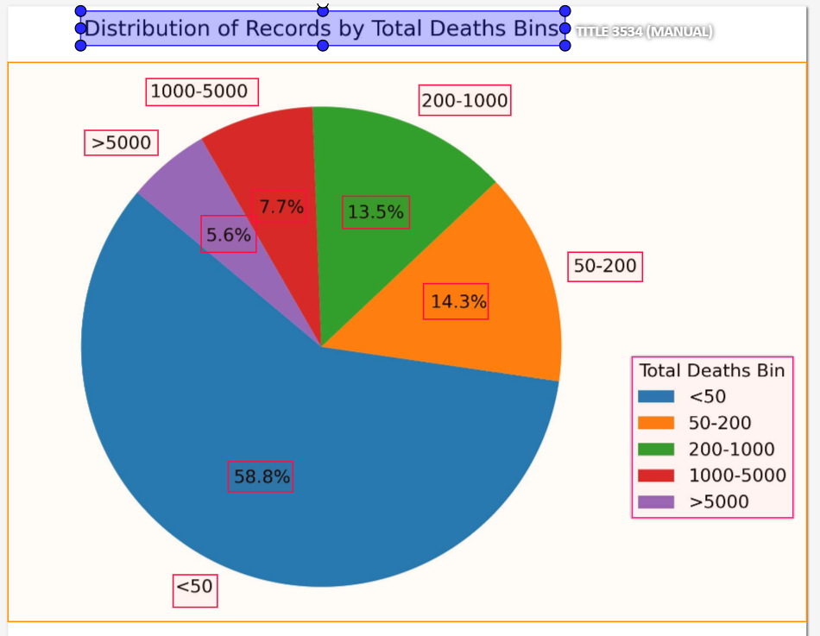
Annotations Tasks
We have completed annotating 1800 chart images, from which 600 are pie charts, 600 are line charts and 600 are bar charts.
Amongst the 1800 charts images, 300 charts were created based on real world dataset pulled from Kaggle.

Slide 12
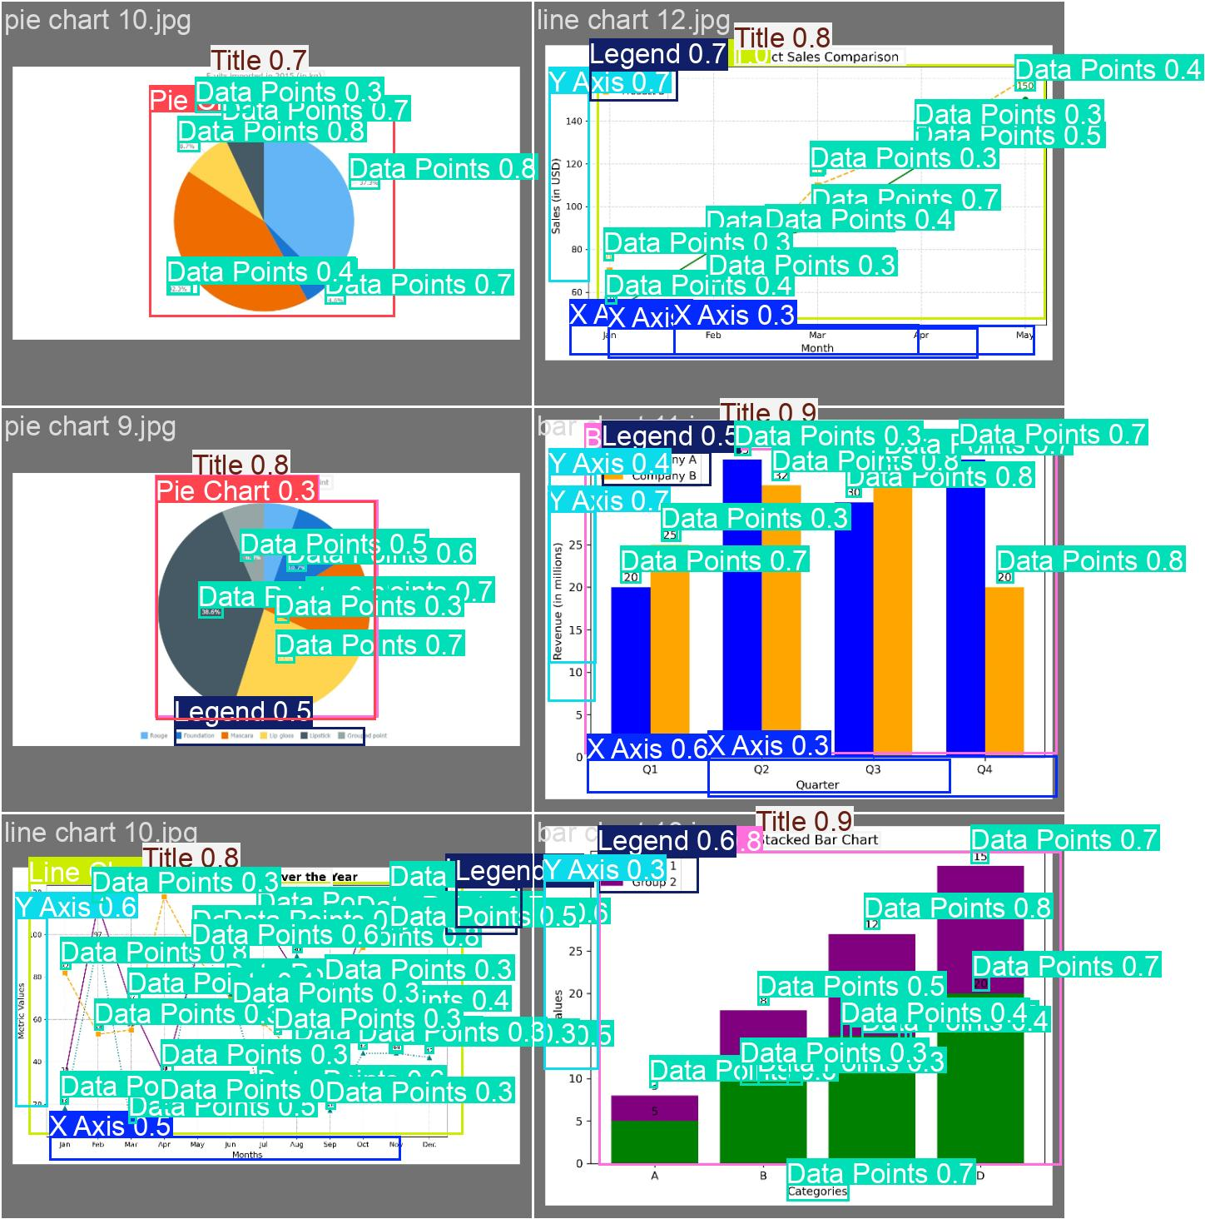
Are 1800 annotated chart, good enough to build a model?
Yes, to build a proof of concept working model it should be good; to build a more generalized model we would need upwards 2000 charts per chart type.
We come to this conclusion, because based on our initial 100 chart training on YOLO, we started to see good results.
DePlot was built on 28,000 data point.
DePlot Paper: https://arxiv.org/abs/2212.10505

Slide 13
Why Use OCR?
Since YOLO only detects objects (not text content), OCR is needed to recognize and extract actual text from detected bounding boxes.
OCR can extract text from scanned documents, receipts, charts, and tables, which is difficult for traditional parsing methods.
OCR works with printed, handwritten, rotated, and stylized text, unlike template-based approaches.
Advanced OCR models (like PaddleOCR) can denoise, segment, and correct distorted text, making it better than simple image-to-text techniques.
OCR automates extraction, making it efficient for large-scale document processing.

Slide 14
Which OCR to use?
Feature | PaddleOCR (Best Choice) | EasyOCR (Good Alternative) | Tesseract (Basic & Outdated)
Accuracy (Text & Numbers) | High (Best for structured text & digits) | Moderate (Struggles with numbers) | Low (Good only for printed text, fails on complex layouts)
Speed | Fast (GPU acceleration available) | Fast (PyTorch-based, slightly faster than PaddleOCR) | Slow (CPU-based, struggles with large documents)
Handwritten Text Recognition | Supports, but not perfect | Limited support | Poor handwriting recognition
Rotated & Angled Text | Detects and corrects angles automatically | Struggles with rotated text | Fails on rotated text
Dense/Overlapping Text | Better handling for tables, invoices, receipts | Struggles with close characters | Fails on overlapping text
Table Extraction Support | Works well with structured data | No dedicated table detection | Requires post-processing
Custom Training Support | Easily trainable on custom data | No fine-tuning support | No deep learning-based training
GPU Acceleration | Supports GPU (TensorRT, Paddle Lite) | Supports GPU (PyTorch-based) | CPU only (Slow for large images)
Best Use Case | Invoices, ID cards, receipts, tabular data | Fast OCR for general text | Basic OCR for printed text only
We should go for PaddleOCR outperforms other OCR tools with superior accuracy for structured data, numbers, and overlapping text. It supports GPU acceleration, multi-language text, and robust table extraction, making it ideal for real-world document processing.

Slide 15
Next Steps
Object Detection:
Use YOLO to detect and identify key elements of the chart.
Text Extraction:
Use PaddleOCR to extract text from the cropped images
Extracting Tabular Data:
Convert chart data into a structured table for further analysis.
Text Generation and Summarization:
Generate detailed text analysis and summarize it for clear, easy interpretation.

Slide 16
Project Milestones & Timelines
Object Detection:
Complete training by February 28th.
Extracting Tabular Data:
Develop a rough model by February 28th.
Finalize the model by March 7th.
Integrate the model by March 14th.
Text Generation and Summarization:
Initiate parallel work, leveraging our NLP course project on summarizing tabular data.

Slide 17
GitHub Link
Below is the link to the GitHub Repository: https://github.com/Neel-Raibole/DataZymes
I would be updating the Roadmap, and it would be ready by the next meeting

Slide 18
Minutes of Meeting
Why YOLO slide
Why OCR, and what OCR
GitHub link for presentation, RoadMap (Jan to April), with ipynb
Annotation Summary
Ensure there are images to represent the details
Put the RoadMap at the start of every presentation
Make the RoadMap more detailed
Data Summary, about annotation and charts
Put links for citations, and research papers

